Slide 1


SIMATS ENGINEERING
SAVEETHA INSTITUTE OF MEDICAL AND TECHNICAL SCIENCES
Capstone project presentation
Retail Sales Analysis and Demand Forecasting
Team - 10
CSA1606– Data warehousing and Data Mining
Guided By
Dr.S.Renuga
Presented by:
Panga Sudharshan Reddy(192372204)
Y.Vamsi Babu (192311145)

Slide 2
INTRODUCTION
Retail Sales Analysis helps businesses understand sales performance, customer purchasing behavior, and product demand by analyzing historical sales data.
Demand Forecasting predicts future product demand using historical sales data, enabling better business planning and decision-making.
Accurate forecasting helps maintain optimal inventory levels by reducing stock shortages and excess inventory.
The project supports data-driven decision-making, improves operational efficiency, enhances customer satisfaction, and increases business profitability.

Slide 3
OBJECTIVES
To analyze historical retail sales data to identify sales trends, customer purchasing behavior, and product performance.
To preprocess and analyze the dataset by cleaning the data and performing Exploratory Data Analysis (EDA) to identify useful patterns and seasonal trends.
To develop a demand forecasting model using historical sales data to accurately predict future product demand.
To optimize inventory management and support business decision-making by reducing stock shortages, improving sales planning, and increasing overall profitability.

Slide 4
PROBLEM STATEMENT
Retail businesses generate large volumes of sales data, but it is not effectively analyzed to support business decisions.
Inaccurate demand forecasting leads to stock shortages or excess inventory, increasing operational costs and reducing sales.
Traditional forecasting methods fail to accurately capture changing customer preferences, seasonal trends, and market demand.
A Retail Sales Analysis and Demand Forecasting system is needed to predict future demand, improve inventory management, and enhance overall business profitability.

Slide 5
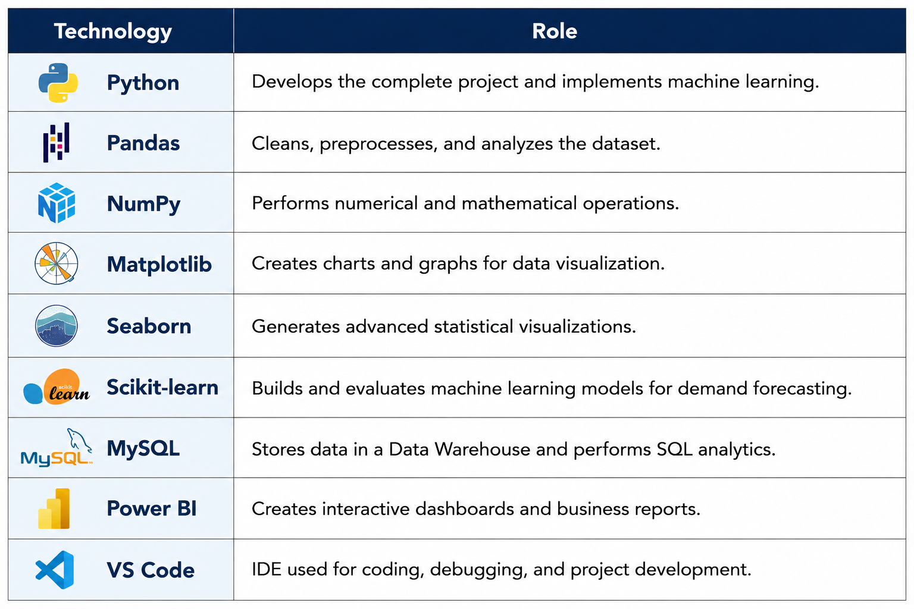
Technologies Used

Slide 6
Module 1: Data Warehousing & Business Intelligence
Collect retail sales data from POS systems, online stores, customer transactions, and inventory databases.
Clean, validate, and integrate the collected data into a centralized Data Warehouse to ensure accuracy and consistency.
Organize and analyze the data using Business Intelligence (BI) techniques to identify sales trends, customer behavior, and product performance.
Prepare structured data for the Retail Sales Analysis and Demand Forecasting module to support accurate sales predictions and better business decision-making.

Slide 7
Module 2: Data Mining & Sales Forecasting
Receive cleaned retail sales data from the Data Warehousing & Business Intelligence module for analysis and forecasting.
Apply Data Mining techniques to identify customer purchasing behavior, product demand, and seasonal sales trends.
Use Machine Learning and statistical forecasting algorithms to accurately predict future sales demand.
Generate demand forecasts that help optimize inventory management, improve sales planning, reduce stock shortages, and support better business decision-making.

Slide 8
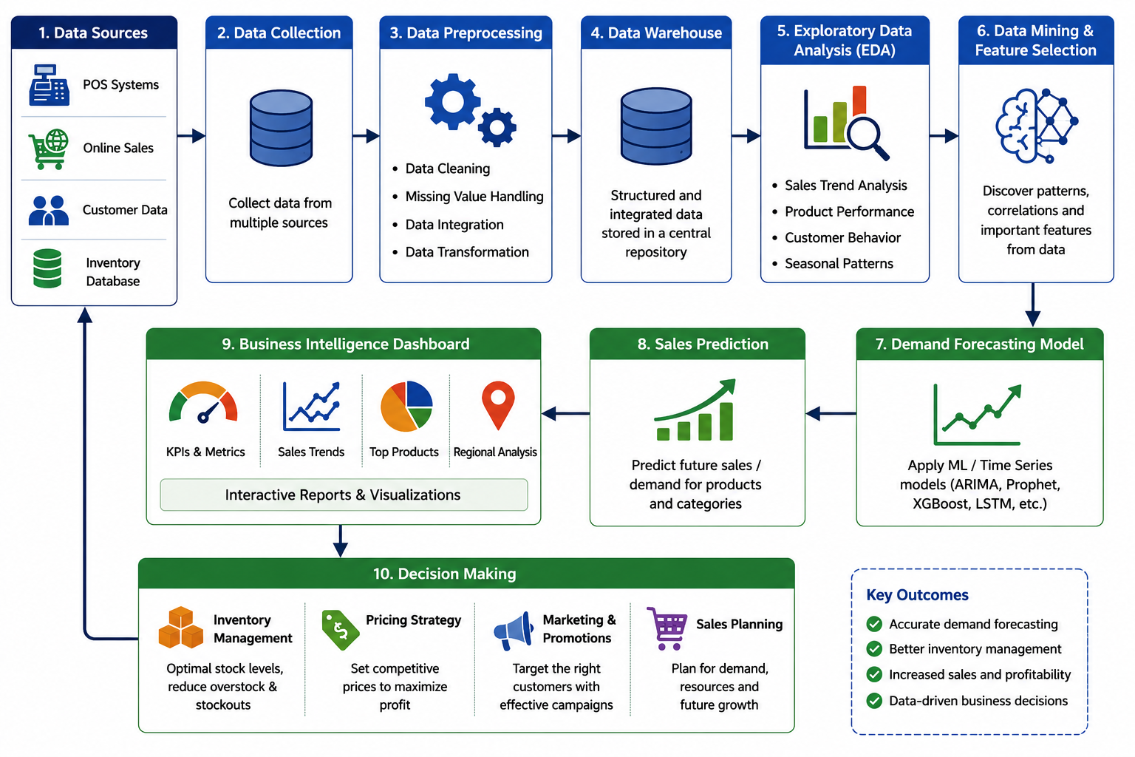
SYSTEM DESIGN

Slide 9
RESULTS & DISCUSSION
The system successfully analyzed historical retail sales data and identified sales trends, seasonal patterns, and customer purchasing behavior.
The demand forecasting model accurately predicted future product demand, helping retailers improve inventory planning.
The analysis reduced stock shortages and excess inventory, leading to better inventory management and lower operational costs.
The proposed system improved sales planning, customer satisfaction, and business profitability through data-driven demand forecasting.

Slide 10
CONCLUSION
The proposed system effectively analyzes historical sales data to identify sales trends, customer behavior, and product performance.
The demand forecasting model accurately predicts future product demand, helping retailers improve inventory management and reduce stock shortages.
The system provides valuable insights that support better pricing, marketing, and sales planning decisions.
Overall, the project improves operational efficiency, enhances customer satisfaction, and increases business profitability through data-driven decision-making.

Slide 11
REFERENCES
Makridakis, S., Spiliotis, E., & Assimakopoulos, V. (2022). The M5 Accuracy Competition: Results, Findings, and Conclusions. International Journal of Forecasting, 38(4), 1346–1364.
Hyndman, R. J., & Athanasopoulos, G. (2023). Forecasting: Principles and Practice (3rd Edition). OTexts, Melbourne, Australia.
Chollet, F. (2023). Deep Learning with Python (2nd Edition). Manning Publications.
IBM Corporation. (2024). IBM Business Analytics and Demand Forecasting Solutions. Available at: https://www.ibm.com/analytics
Microsoft Corporation. (2024). Microsoft Power BI Documentation – Retail Sales Analytics. Available at: https://learn.microsoft.com/power-bi
Oracle Corporation. (2024). Oracle Retail Demand Forecasting and Inventory Management. Available at: https://www.oracle.com/retail/ \
Pandas Development Team. (2025). Pandas Documentation. Available at: https://pandas.pydata.org/
Scikit-learn Developers. (2025). Scikit-learn: Machine Learning in Python. Available at: https://scikit-learn.org/

Slide 12


